Slide 1
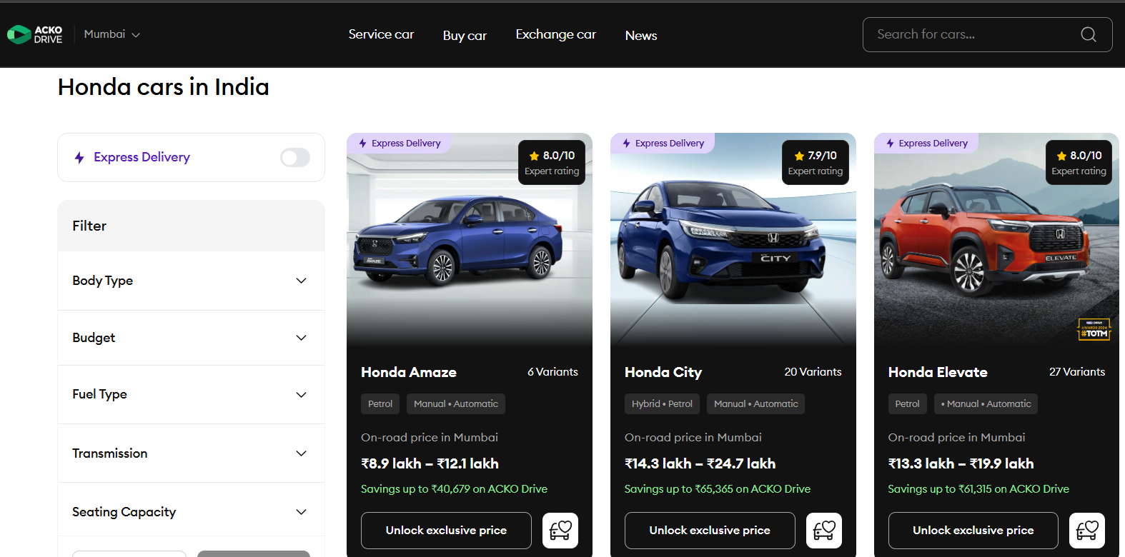
Mini Project By Team-D
Honda Car Data Scraping Using Jupyter Notebook

Slide 2
Meet Our Team:
CHAITANYA JOGI -TEAM LEAD
DEEPAK CHOUDHARY - TEAM LEAD
Research lead | Quality Reviewer | Ppt & Coordinator
Documentation Report Writer
MANOJ YANAMADALA - CO-LEAD 1
MOHD MUDABBIR - CO-LEAD 2
Presentation Designer
Web Scraping Developer -1
SOWMIYA S - MEMBER
SIVA ADAPA - MEMBER
Data Organizer
Web Scraping Developer -2
SYED HASANUDDIN - MEMBER
KUKATAL KAMAL - MEMBER
Implementation & Developer -3
Data Cleaner
This text-focused design ensures a clear, professional introduction to each team member, emphasizing their roles and contributions.

Slide 3

Introduction: Unlocking Data with Web Scraping
Web scraping is the automated extraction of data from websites. It transforms unstructured web content into structured data, ready for analysis.
We scrape car data to gather market insights, analyze pricing trends, compare specifications, and inform purchasing decisions without manual, time-consuming data collection.

Slide 4




Essential Tools & Libraries
Python
BeautifulSoup (bs4)
The versatile programming language forming the backbone of our scraping script.
A library for parsing HTML and XML documents, making it easy to navigate the parsed tree.
Requests
Pandas
Simplifies sending HTTP requests, allowing us to fetch web pages.
A powerful data manipulation and analysis library, perfect for structuring our extracted data into DataFrames.

Slide 5
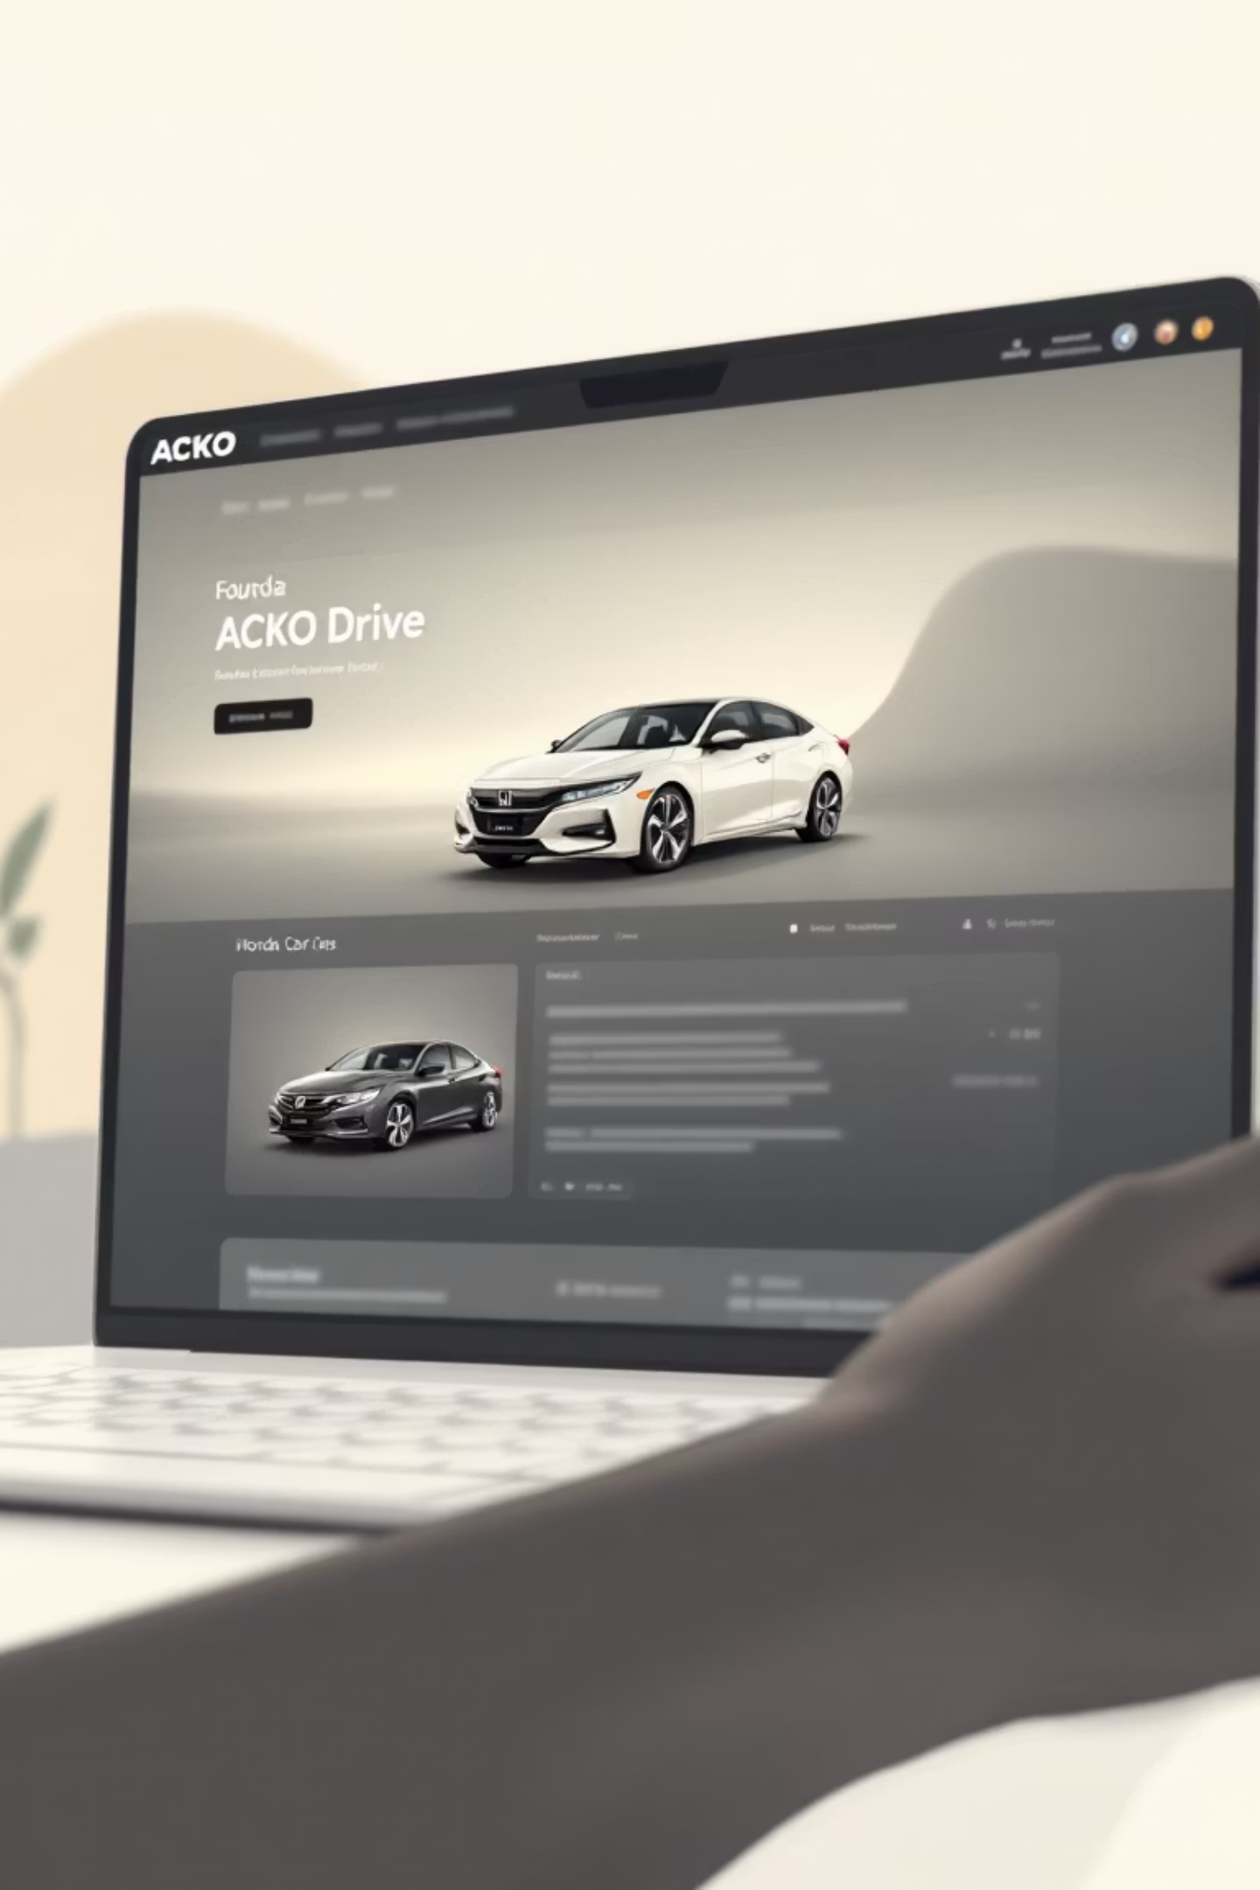
Target Website: ACKO Drive - Honda Listings
Our target was the ACKO Drive website, specifically their Honda car listings page. This page provides a wealth of information on various Honda models, including key specifications and pricing details. We focused on extracting data points crucial for comparative analysis.

Slide 6




Web Scraping Workflow: A Step-by-Step Approach
Send HTTP Request
Parse HTML Content
Using the requests library to fetch the HTML content of the ACKO Drive Honda page.
Utilizing BeautifulSoup to parse the raw HTML into a navigable object structure.
Locate Car Cards
Extract Specific Data
Identifying specific HTML elements (e.g., div tags with particular classes) that contain individual car listing details.
Drilling down within each car card to pull out relevant information like model name, price, and features.

Slide 7
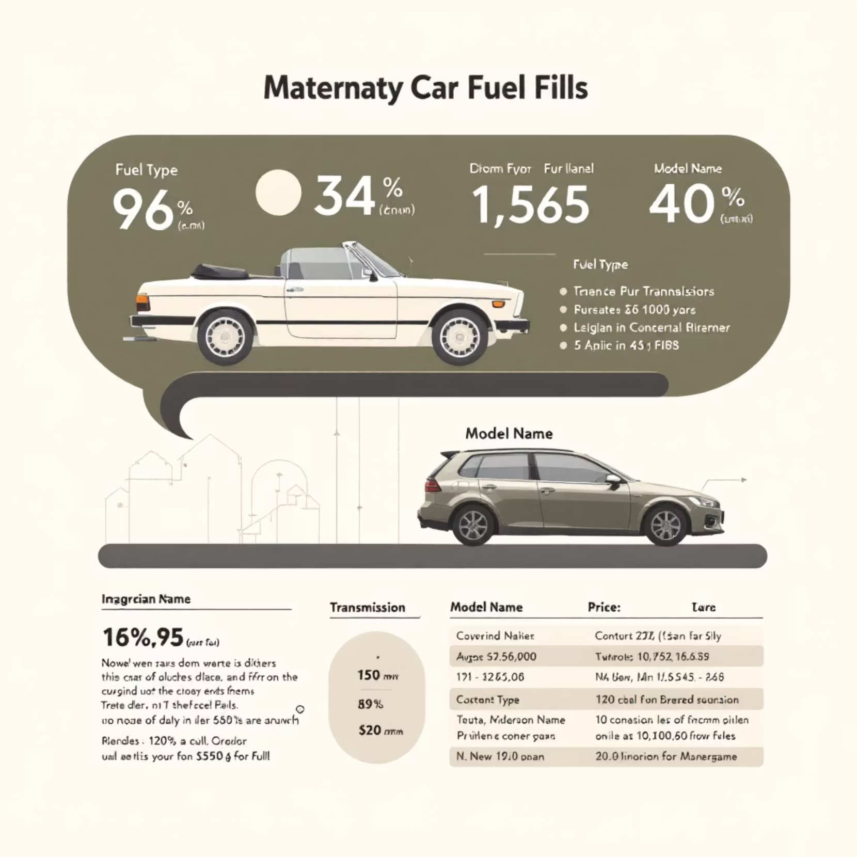
Data Extracted: Key Vehicle Information
Model Name: E.g., Honda City, Honda Amaze
Variants: Different versions of a model (e.g., VX, ZX)
Price Range: Estimated cost of the vehicle (e.g., ₹9.5 L - ₹15 L)
Fuel Type: Petrol, Diesel, Electric, Hybrid
Transmission: Manual, Automatic (CVT, AMT)
User Ratings: Customer reviews or star ratings

Slide 8
Output & DataFrame Structure
After extraction, the data is structured into a Pandas DataFrame for easy analysis and manipulation. Each row represents a car variant, and each column a specific data point.
Honda City
V MT Petrol
F - 13.9 lakh
Petrol
Manual
4.5
Honda City
ZX CVT Petrol
F - 15.0 lakh
Petrol
Automatic
4.6
Honda Amaze
E MT Diesel
F -8.0 lakh
Diesel
Manual
4.2
Honda Amaze
VX CVT Petrol
F -9.8 lakh
Petrol
Automatic
4.3

Slide 9



Conclusion: Insights and Future Enhancements
1
2
3
Importance of Scraping
Uses in Data Analysis
Future Improvements
Web scraping provides invaluable, real-time data for market research, competitive analysis, and data-driven decision-making.
Extracted data can fuel predictive modeling, price optimization, trend identification, and comprehensive market segmentation.
Implement scheduled scraping, integrate with APIs (if available), add sentiment analysis on reviews, and expand to more car brands/websites.

Slide 10


